Slide 1
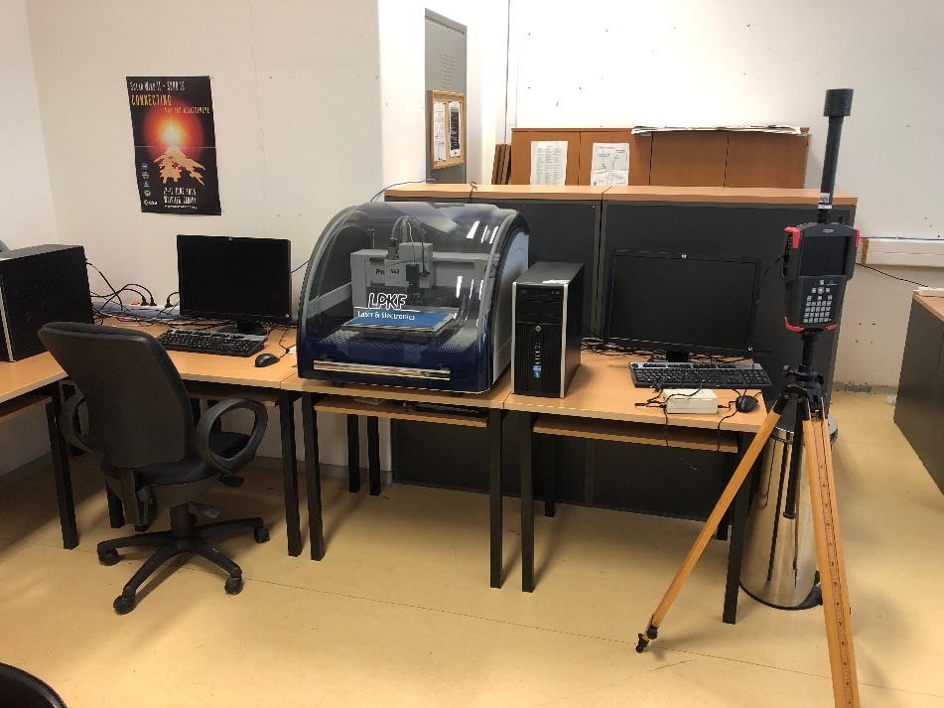
Τηλεπικοινωνιακά Δίκτυα
ΠΜΣ Μηχανικών Ηλεκτρονικών Υπολογιστών και Δικτύων
Διδάσκοντες
Κωνσταντίνος Αγγέλης
Καθηγητής
Ανδρέας Τσορμπατζόγλου
Επίκουρος Καθηγητής
Τμήμα Πληροφορικής & Τηλεπικοινωνιών – Πανεπιστήμιο Ιωαννίνων

Slide 2
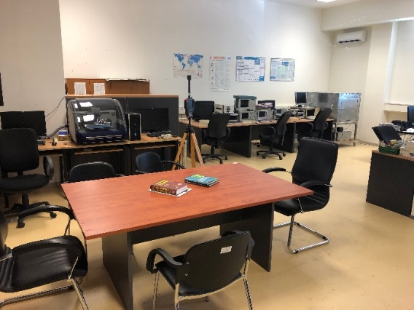
Τηλεπικοινωνιακά Δίκτυα
ΠΜΣ Μηχανικών Ηλεκτρονικών Υπολογιστών και Δικτύων
Βασικές αρχές μετάδοσης
Δίκτυα επικοινωνιών
Τεχνολογία ασύρματης επικοινωνίας
Το ασύρματο κανάλι
Ορθογωνική πολυπλεξία διαίρεσης συχνότητας
Διασπορά φάσματος
Αρχές Διάδοσης Σημάτων - Κυψελοειδή ασύρματα δίκτυα
Συστήματα 4ης-5ης γενιάς και LTE-Advanced
Συστήματα MIMO
Επικοινωνίες μεγάλης εμβέλειας
Συνεργατικά Τηλεπικοινωνιακά Συστήματα
Οπτικά Δίκτυα
Τμήμα Πληροφορικής & Τηλεπικοινωνιών – Πανεπιστήμιο Ιωαννίνων

Slide 3
Σύγχρονα ασύρματα δίκτυα
Οι τεχνολογίες MIMO & OFDM σε συνδυασμό αποτελούν τον ακρογωνιαίο λίθο στα αναδυόμενα ευρυζωνικά ασύρματα δίκτυα
OFDM → Τεχνική Βασιζόμενη στο Διαφορισμό

Slide 4
Τεχνικές Διαφορισμού (Diversity Techniques)
Ο Διαφορισμός (Diversity) βασίζεται στο γεγονός ότι ανεξάρτητα κανάλια υφίστανται ανεξάρτητα φαινόμενα διαλείψεων
Space diversity – techniques involving physical transmission path, spacing antennas
Frequency diversity – techniques where the signal is spread out over a larger frequency bandwidth or carried on multiple frequency carriers
Time diversity – techniques aimed at spreading the data out over time
Use of diversity
Selection diversity – select the best signal
Combining diversity – combine the signals

Slide 5
MULTIPLE INPUT MULTIPLE OUTPUT (MIMO) ANTENNAS
Use antenna arrays for
Diversity (Διαφορισμός) – different signals from different antennas
Multiple streams– parallel data streams
Beamforming (Μορφοποίηση Δέσμης) – directional antennas
Multi-user MIMO – directional beams to multiple simultaneous users
Modern systems
4 × 4 (4 transmitter and 4 reciever antennas)
8 × 8
Two dimensional arrays of 64 antennas
Massive MIMO with many more antennas

Slide 6
5.9 Four Uses of MIMO

Slide 7
Διασπορά Φάσματος και OFDM
Frequency diversity examples:
Ορθογωνική Πολυπλεξία Διαίρεσης Συχνότητας (Orthogonal Frequency Division Multiplexing - OFDM)
Διασπορά Φάσματος (Bandwidth expansion or Spread Spectrum)

Slide 9
Orthogonal Frequency Division Multiplexing (OFDM)

Slide 10
Ορθογωνική πολυπλεξία διαίρεσης συχνότητας Orthogonal Frequency Division Multiplexing (OFDM) Εισαγωγικά
OFDM created great expansion in wireless networks
Greater efficiency in bps/Hz
Main air interface in the change from 3G to 4G
Also expanded 802.11 rates
Critical technology for broadband wireless access
WiMAX

Slide 11
8.1 Ορθογωνική πολυπλεξία διαίρεσης συχνότητας
Also called multicarrier modulation (Διαμόρφωση πολλαπλής φέρουσας)
Start with a data stream of R bps
Could be sent with bandwidth Nf_{b}
With bit duration 1/R
OFDM splits into N parallel data streams
Called subcarriers
Each with bandwidth f_{b}
And data rate R/N (bit time N/R)

Slide 12
Figure 8.1 Conceptual Understanding of Orthogonal Frequency Division Multiplexing

Slide 13
Ορθογωνικότητα - Orthogonality
The spacing of the f_{b} frequencies allows tight packing of signals
Actually, with overlap between the signals
Signals at spacing of f_{b} ,2f_{b}, 3f_{b} ,etc.
The choice of f_{b} is related to the bit rate to make the signals orthogonal
Average over bit time of s₁(t) × s₂(t) = 0
Receiver is able to extract only the s₁(t) signal
If there is no corruption in the frequency spacing
Traditional FDM makes signals completely avoid frequency overlap
OFDM allows overlap which greatly increases capacity

Slide 14
Figure 8.2 Illustration of Orthogonality of OFDM

Slide 15
Ορθογωνικότητα - Orthogonality
Given an OFDM subcarrier bit time of T
f_{b} must be a multiple of 1/T
Example: IEEE 802.11n wireless LAN
20 MHz total bandwidth
Only 15 MHz can be used
48 subcarriers
f_{b} = 0.3125 MHz
Signal is translated to 2.4 GHz or 5 GHz bands

Slide 16
Οφέλη της τεχνικής OFDM - Benefits of OFDM
Frequency selective fading only affects some subcarriers
Can easily be handled with a forward error-correcting code
More importantly, OFDM overcomes intersymbol interference (ISI)
ISI is a caused by multipath signals arriving in later bits
OFDM bit times are much, much longer (by a factor of N)
ISI is dramatically reduced
N is chosen so the root-mean-square delay spread is significantly smaller than the OFDM bit time
It may not be necessary to deploy equalizers to overcome ISI
Eliminates the use of these complex and expensive devices.

Slide 17
Υλοποίηση της τεχνικής OFDM - OFDM Implementation
Inverse Fast Fourier Transform (IFFT)
The OFDM concept (Figure 8.1) would use N oscillators for N different subcarrier frequencies
Expensive for transmitter and receiver
Discrete Fourier Transform (DFT) processes digital signals
If N is a power of two, the computational speed dramatically improves by using the fast version of the DFT (FFT).
Transmitter takes a symbol from each subcarrier
Makes an OFDM symbol
Uses the Inverse FFT to compute the data stream to be transmitted
OFDM symbol provides the weights for each subcarrier
Then it is sent on the carrier using only one oscillator

Slide 18
Figure 8.3 IFFT Implementation of OFDM

Slide 19
Κυκλικό Πρόθεμα - Cyclic prefix
OFDM’s long bit times eliminate most of the ISI
OFDM also uses a cyclic prefix (CP) to overcome the residual ISI
Adds additional time to the OFDM symbol before the real data is sent
Called the guard interval
ISI diminishes before the data starts
Data from the end of the OFDM symbol is used as the CP
Simplifies the computations

Slide 20
Figure 8.4 Cyclic Prefix
Ονομαστικό κυκλικό πρόθεμα: 7% &
Εκτεταμένο κυκλικό πρόθεμα: 25% επιπλέον σύμβολα.
π.χ.: OFDM με 1024 υποφέρουσες με χρήση Ονομαστικού κυκλικού προθέματος έχει επιπλέον 0.07*1024=72 σύμβολα φύλαξης

Slide 21
Δυσκολίες υλοποίησης της OFDM - Difficulties of OFDM
Peak-to-average power ratio (PAPR) (Λόγος Μέγιστης προς Μέση Ισχύ)
For OFDM signals, this ratio is much higher than for single-carrier signals
OFDM signal is a sum of many subcarrier signals
Total can be very high or very low
Power amplifiers need to amplify all amplitudes equally
Should have a linear characteristic with slope K on a V_{out} vs. V_{in} curve
Yet practical amplifiers have limited linear ranges
Causing distortion if outside the linear range

Slide 22
Figure 8.5 Ideal and Practical Amplifier Characteristics

Slide 23
Figure 8.6 Examples of Linear and Nonlinear Amplifier Output

Slide 24
Δυσκολίες υλοποίησης της OFDM - Difficulties of OFDM
PAPR problem (continued)
Expensive amplifiers have wide linear range
Solutions
Could reduce the peak amplitude
Called input backoff
But this would increase the signal to interference plus noise ratio (SINR)
Noise and interference would be relatively stronger because signal is weaker
Specific PAPR reduction techniques can be used
Specialized coding, phase adjustments, clipping, etc.
Single-carrier FDMA (SC-FDMA)

Slide 25
Δυσκολίες υλοποίησης της OFDM - Difficulties of OFDM
Intercarrier Interference (ICI) (Διαφεροντική Παρεμβολή)
OFDM frequencies are spaced very precisely
Channel impairments can corrupt this
Cyclic prefix helps reduce ICI
But CP time should be limited so as to improve spectral efficiency
A certain level of ICI may be tolerated to have smaller CPs
Doppler spread, mismatched oscillators, or even one subcarrier can cause ICI
Spacing between subcarriers may need to be increased
Could also use different pulse shapes, self-interference cancellation, or frequency domain equalizers.

Slide 26
Πολλαπλή πρόσβαση με Ορθογωνική διαίρεση συχνότητας - OFDMA
Orthogonal Frequency Division Multiple Access (OFDMA) uses OFDM to share the wireless channel
Different users can have different slices of time and different groups of subcarriers
Subcarriers are allocated in groups
Called subchannels or resource blocks
Too much computation to allocate every subcarrier separately

Slide 27
Figure 8.7 OFDM and OFDMA

Slide 28
Πολλαπλή πρόσβαση με Ορθογωνική διαίρεση συχνότητας - OFDMA
Subchannel allocation
Adjacent subcarriers (Παρακείμενες υποφέρουσες) – similar SINR
Must measure to find the best subchannel
Regularly spaced subcarriers (Υποφέρουσες σε τακτικές αποστάσεις) – diverse SINR
Randomly space subcarriers (Υποφέρουσες σε τυχαίες αποστάσεις) – diverse SINR and reduced adjacent-cell interference

Slide 29
Ευκαιριακός χρονοπρογραμματισμός - Opportunistic scheduling
Schedule subchannels and power levels based on
Channel conditions
Data requirements
Adjust in a dynamic fashion
Use channel variations as an opportunity to schedule the best choice in users
Hence the term opportunistic scheduling
Criteria (maybe more than one used simultaneously)
System efficiency (αποδοτικότητα) – pick users with best throughput (ρυθμοαπόδοση)
Fairness (αμεροληψία) – proportional fairness considers the ratio of users’ current rates to the users’ average rates to know when a channel is best for them
Requirements – audio, video
Priority – public safety, emergency, or priority customers

Slide 30
8.3 FDMA απλής φέρουσας – (SC-FDMA)
SC-FDMA has similar structure and performance to OFDMA
But lower PAPR
Mobile user benefits – battery life, power efficiency, lower cost
Good for uplinks
Uses extra DFT operation and frequency equalization compared to OFDM
DFT prior to IFFT
Spreads data symbols over all subcarriers
Every data symbol is carried by every subcarrier
Multiple access is not possible
At one time, all subcarriers must be dedicated to one user
Multiple access is provided by using different time slots

Slide 31
Figure 8.8 Simplified Block Diagram of OFDMA and SC-FDMA

Slide 32
Figure 8.9 Example of OFDMA and SC-FDMA

